Slide 1

Order-to-doorstep software for Myanmar’s cash-on-delivery shops.
လမ်းပြ · Team Zero_Lag · AI Ocean MM
Notes:
Title slide. Hold here through the intro, then move to the next slide on “Let’s walk through how an order actually moves through LannPya.”
1

Slide 2







THE TEAM
Zero_Lag
Zaw Lwin Htoo
Yan Lin Naing
Bhone Myat Htut
Min Thant Tun
FSD
UX
BA
PD
Min Kyi Sin Thant
Kyaw Bhone Htet
Zin Min Htet
FE
BE
UI
Notes:
Team Zero_Lag. Each dashed circle is a photo slot: replace it with that person’s headshot (square crop, about 400 × 400 px). FSD full-stack development, FE front end, UX user experience, BE back end, BA business analysis, UI interface design, PD product.
6

Slide 3


STEP 1 · PASTE
Paste a chat order. LannPya reads it.
The shop pastes
LannPya reads and flags
e
Phone 09 450 112 512
Green · OK
Ma Hnin 09 450 112 512
ကမာရွတ် Junction Square
နောက်ဘက်
COD ?
Township Kamayut
Amber · Check
Cash on delivery
Red · Missing
Notes:
“First, when a shop pastes an order message into LannPya, our system reads the mixed Burmese and English text and automatically pulls out the phone number, the township, and the cash-on-delivery amount. If anything looks unclear or incomplete, the system flags it right away with a simple Red, Amber, or Green status so nothing slips through the cracks.”
2

Slide 4

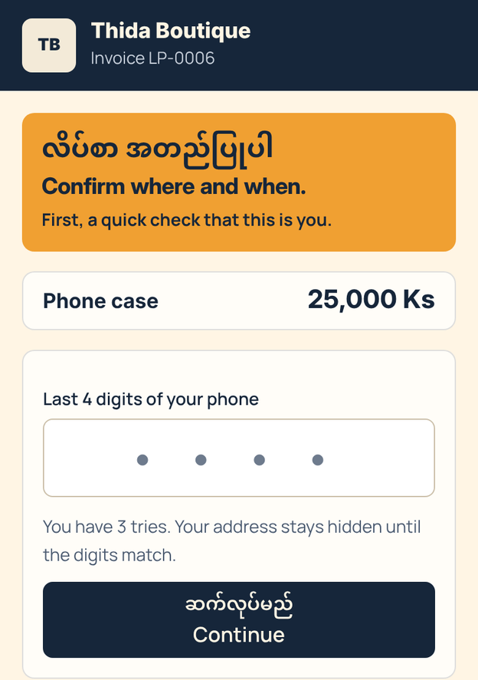
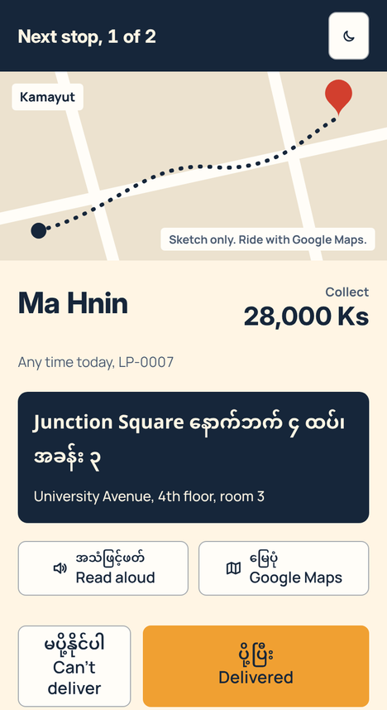
STEPS 2 AND 3 · CONFIRM, DELIVER, CLOSE OUT
Buyer confirms. Rider delivers.
Buyer link
Map pin, time window, note for the rider
Dispatcher
Reviews flags, offers the job
Rider
Accepts, drops off, records cash
Hub
Checks receipts, closes out cash
Notes:
“Second, the buyer gets a secure, private link. With just a few taps, they can drop a map pin on their exact location, pick a delivery time window, and leave instructions for the rider. Third, the dispatcher reviews any flagged changes on their dashboard and sends the job offer to an available rider. The rider accepts the job on their phone, completes the drop-off, and records the exact cash collected. At the end of the shift, the hub checks the receipts and closes out the cash with a clear, traceable record.”
3

Slide 5



WHY IT STANDS OUT
Built for how Myanmar shops work today
No new app for buyers
No perfect addresses
No black-box guessing
A private link in the chat they already use
A pin and a landmark are enough
Local-language rules, with a person checking each key step
Notes:
“What makes LannPya practical is that it is built for how Myanmar shops actually work today. We don’t force customers to download a new app or type perfect addresses. And instead of using unpredictable black-box AI to guess addresses, our parser uses strict, reliable local-language rules combined with human review at every important step.”
4

Slide 6

BUSINESS MODEL
Software for shops and hubs
0
Bikes or riders to buy
Monthly subscription
Runs on the shop’s and hub’s own team
Priced by order volume
TODAY
NEXT
Working prototype runs the full flow locally
Pilot shops and delivery teams on live orders
Notes:
“On the business side, LannPya is built as software for existing shops and courier hubs—meaning we don’t need to buy motorbikes or hire our own fleet. Our proposed model is a simple monthly subscription based on order volume. Today, our working prototype handles this entire flow locally. Next, we are looking for local shops and delivery teams to join us as pilot partners so we can test LannPya on live orders and measure how much time it saves. Let’s take a quick 30-second look at the app in action.”
5

